Slide 1

Hotel Management Project
By :
GARIMA – 191210020
Jaivardhan - 191210024

Slide 2
Project Overview
The project ,Hotel Management System is a web based application that allows the hotel manager to handle all hotel activities online.
Interactive GUI and ability to manage several hotel bookings and rooms make this system very flexible and convenient .The
Hotel manager is a very busy person and doesn't have time to sit and manage the entire activities manually on paper. This
application give him the power and flexibility to manage the entire system from a single online system. Hotel Management project
provides room booking, staff management and other necessary hotel management features. The system allows manager to post
available rooms in the system. Customers can view and book room online. Admin has the power to either approve and disapprove the
customer’s booking request. Other hotel services can also be viewed by the customer’s and can book them too.
The system is hence helpful for both customers and managers to portable manage the hotel activities.

Slide 3
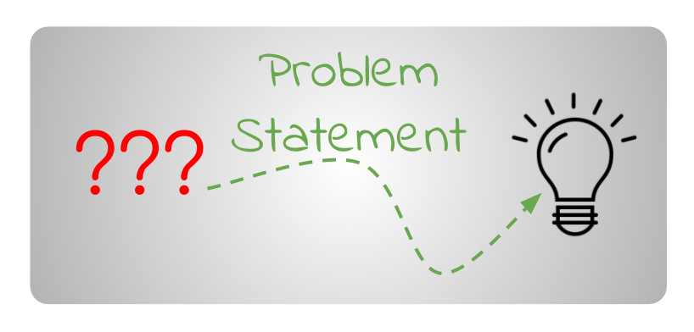
Problem Statement
The hotel management requires a computer software package to facilitate the automation of many manual tasks which will be perform by the system itself. The hotel contains a number of hotel rooms available for hire to guests. The information relevant to each room is • Room number Basic price • Maximum Occupancy Type of room (single, double, twin, executive, suite) .

Slide 4
Continued
The price of room is the basic room price with any seasonal price adjustment added. Potential guests can reserve one or more room for a specified period using this website. These reservation are handled by the receptionist. The potential guests requests the type of the room, arrival date, duration (or departure date). A search is made for the availability of rooms for the dates required. If successful, the customer is informed the details and the price. The receptionist can also make a reservation for potential guests who arrive without reservation, the deposit payment must be made at the time of initial reservation

Slide 5
Proposed System
The hotel management user provides the quality service to the end user. This project aims at creating
on hotel management system which can be used by Admin and Customers. The admin to advice/publish
the availability of rooms in different hotels and customers are checking the availability of rooms in required hotel.
Customers should be able to know the availability of the rooms on a particular date to reserve in hotel.
They should be able to reserve the available rooms according to their need in advance, to make their
stay comfortable. The Admin hands the booking information of customers. The users can register and log into the system.
The administrator will know the details of reservation .

Slide 6
Contributions
All the Front-End part of the project is done by Jaivardhan. Including Animations(Use of Bootstrap, HTML), Frameworks Using JavaScript.
All the Back-End part of the project is done by Garima. Including MySQL queries, connecting project with a database and constructing a new database.

Slide 7
For knowing more details about Project check the link below
Code Files : https://drive.google.com/file/d/1W2YPSz1DEbOpUbbco33H7Ngafj2Ju7qM/view?usp=sharing
Installation Guide : https://drive.google.com/file/d/1HbG1Mr-dZI0pl-VoRzroxX5eOQPyQhvb/view?usp=sharing
Video Of Project : https://drive.google.com/file/d/1bzexsCbsCFYa3dpieOeWlc_zoxgIZIKx/view?usp=sharing
Folder Containing all files related to project : https://drive.google.com/drive/folders/1eOYBfLhuKya0DSo2Kaof2i2dFsE2AH9W?usp=sharing

Slide 8
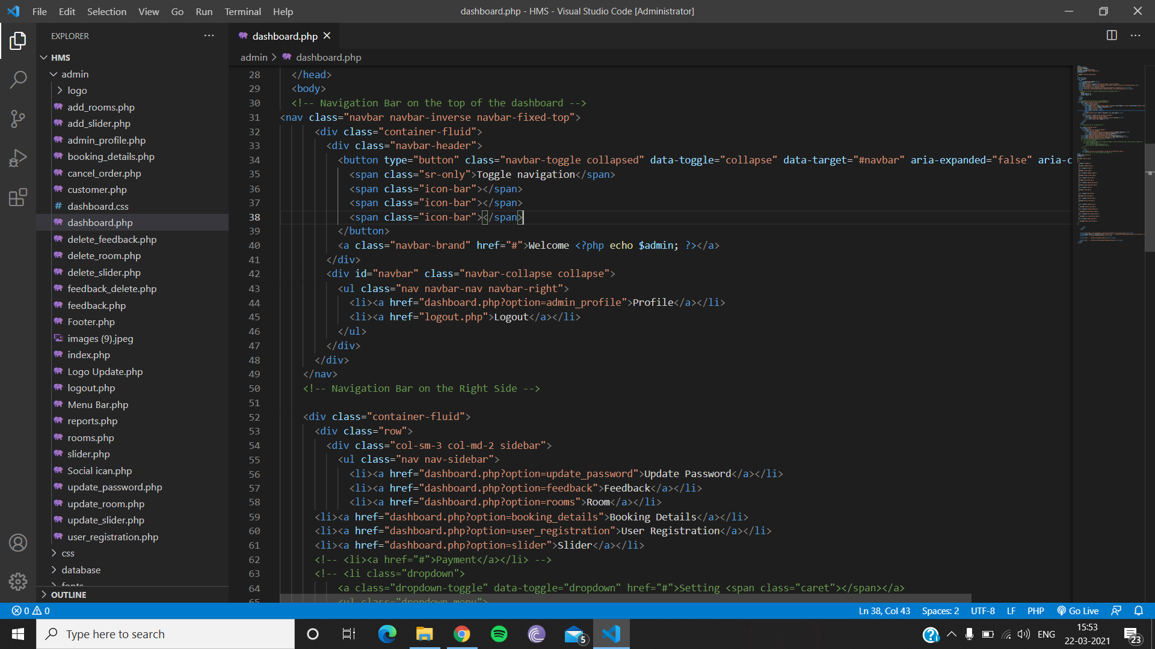
Coding Part

Slide 9
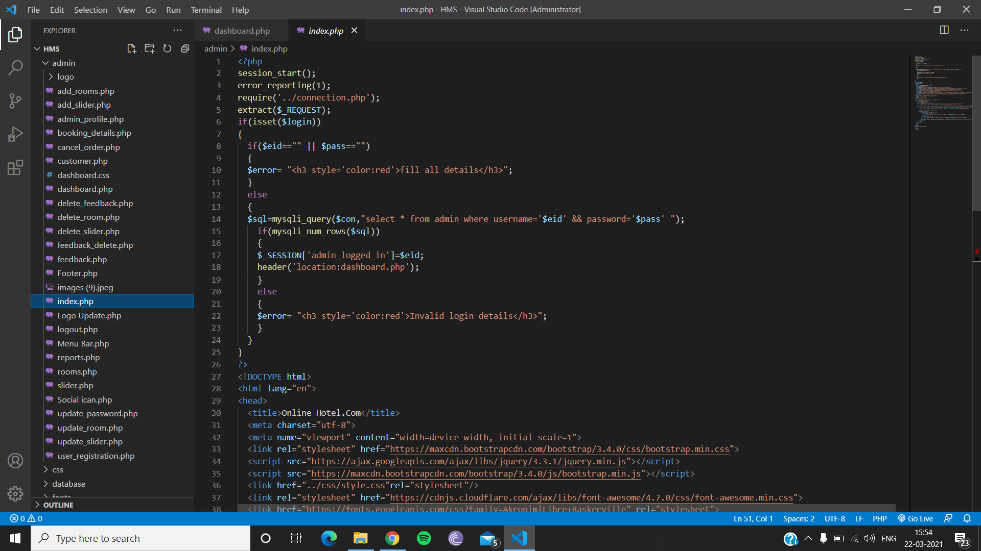
Continued

Slide 10
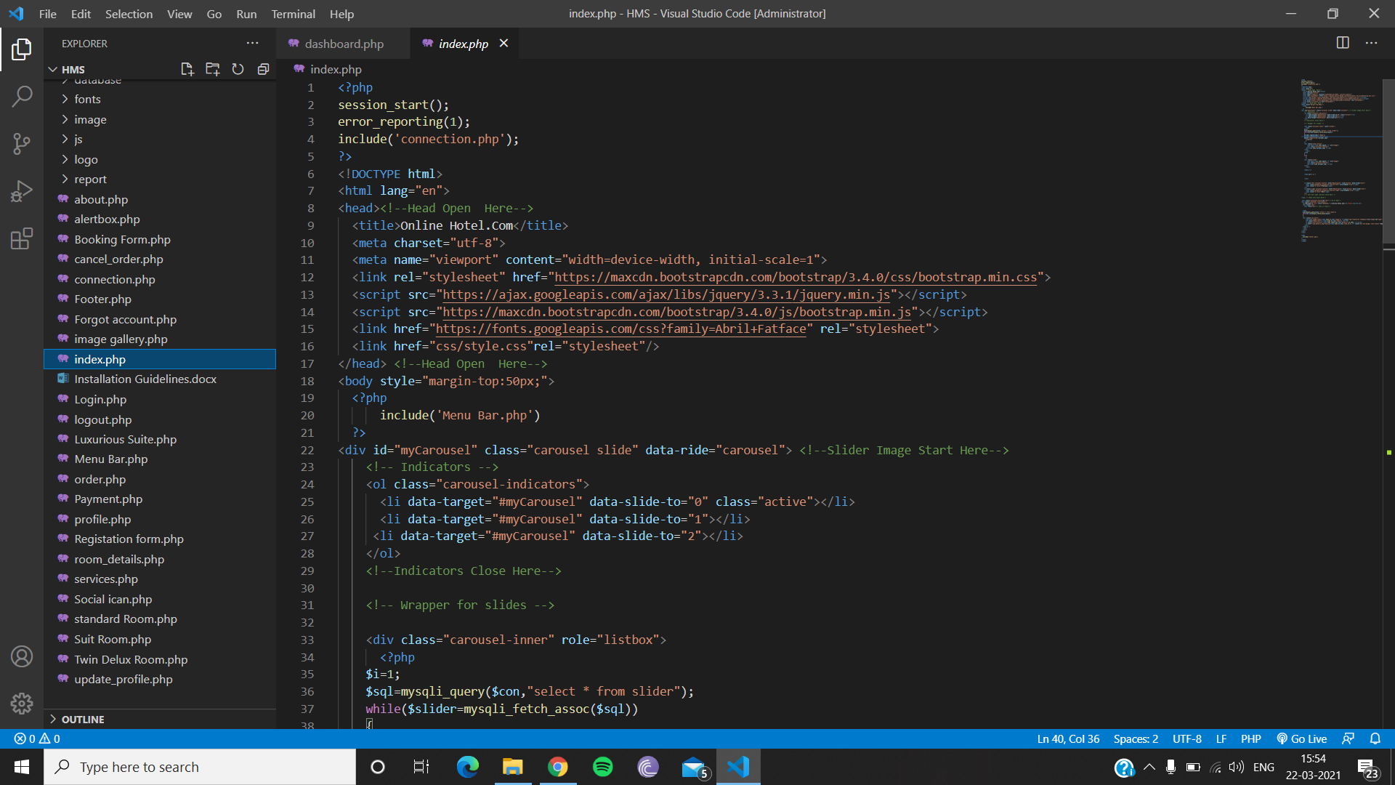
Continued

Slide 11
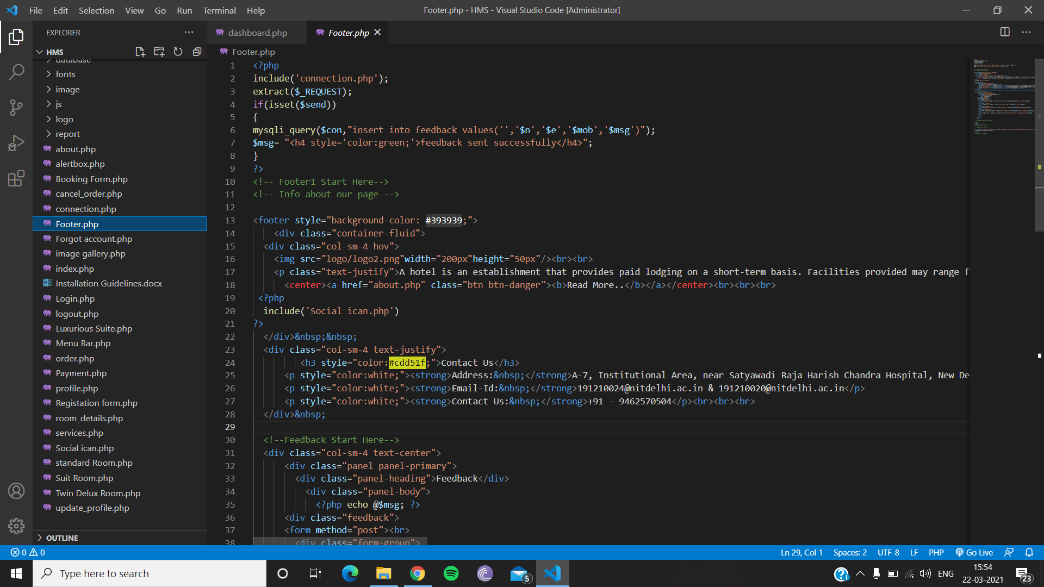
Continued

Slide 12
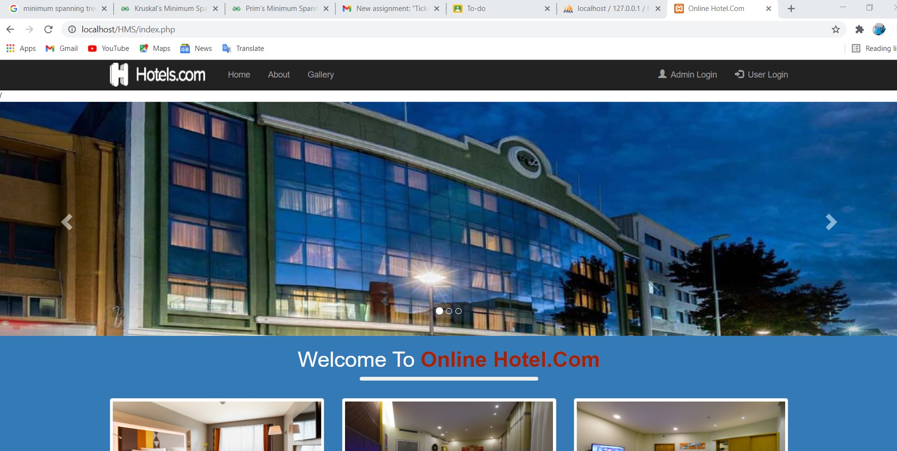
Overview Of Project

Slide 13
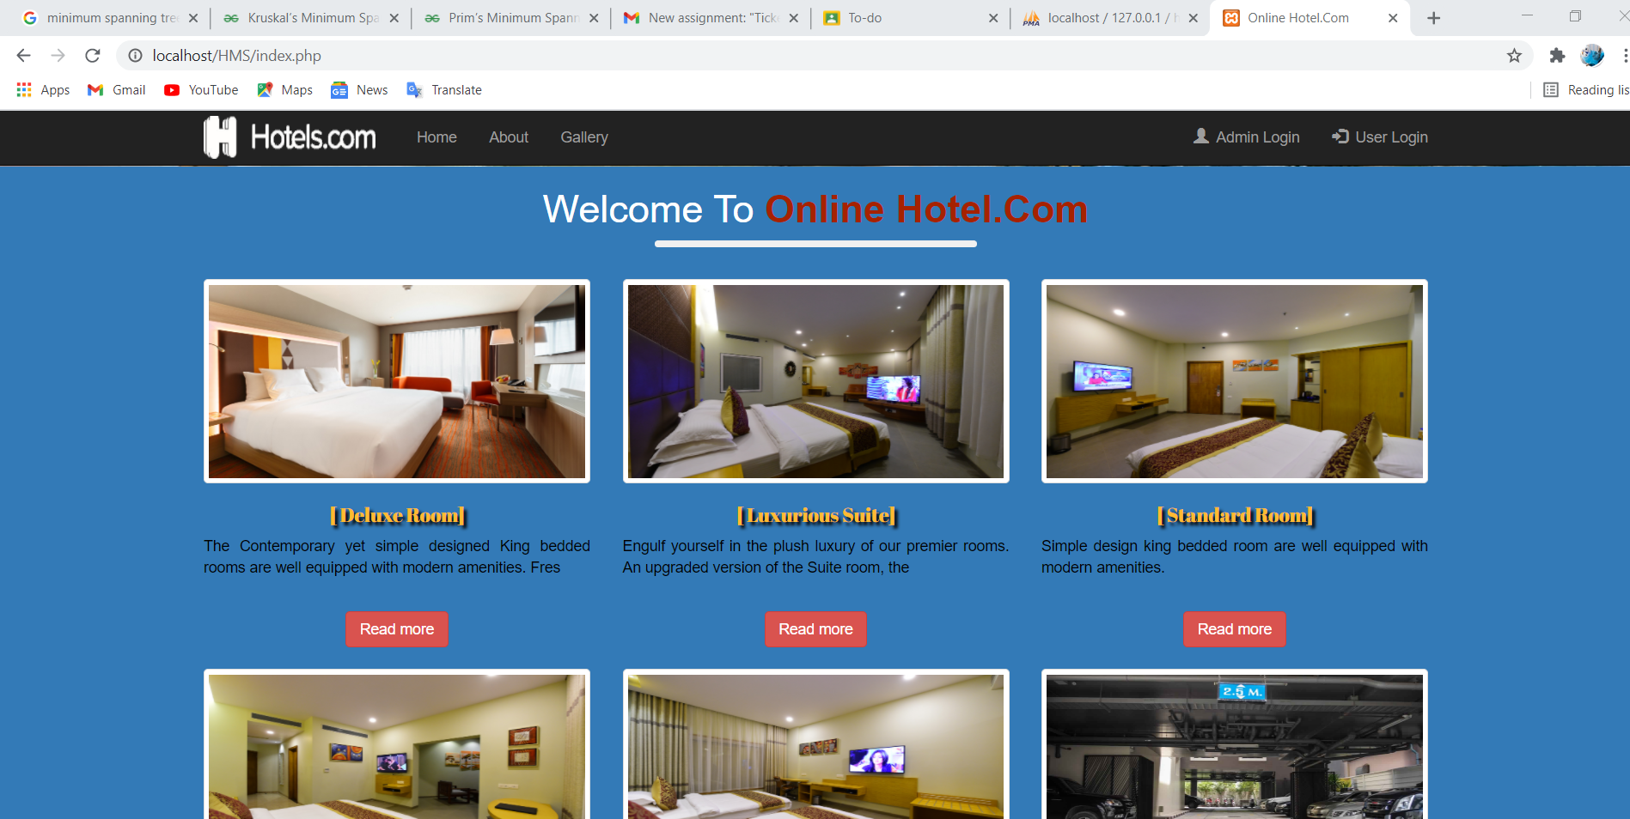

Slide 14
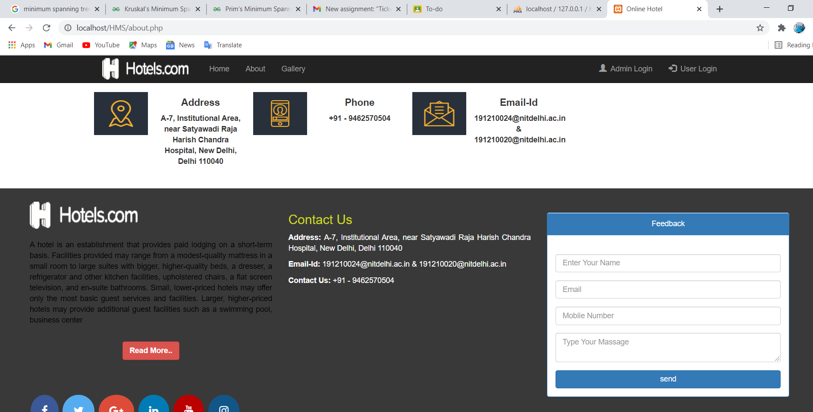

Slide 15
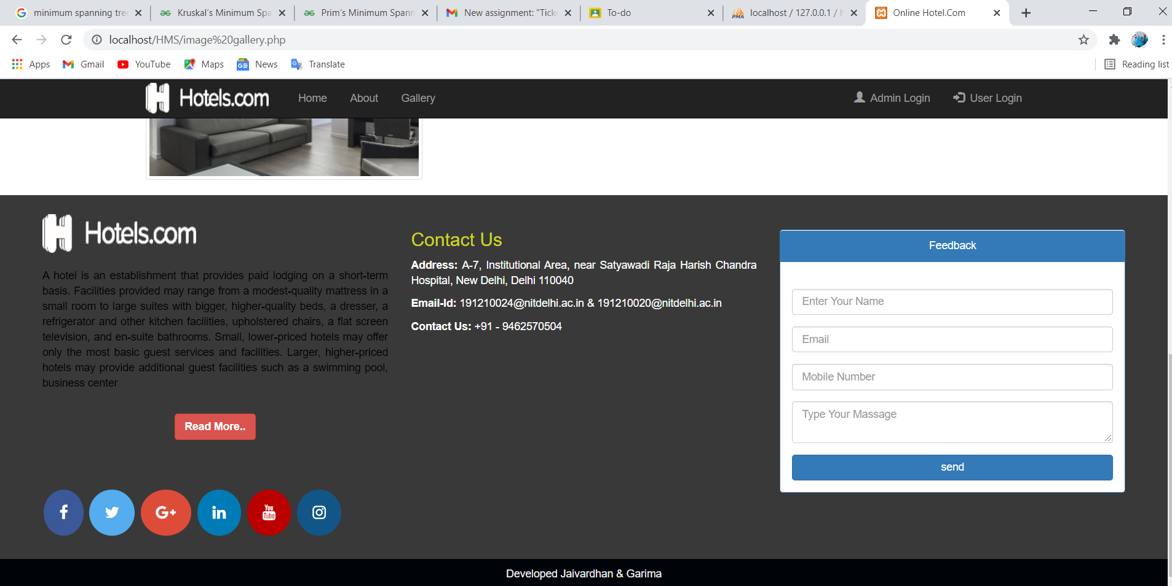

Slide 16
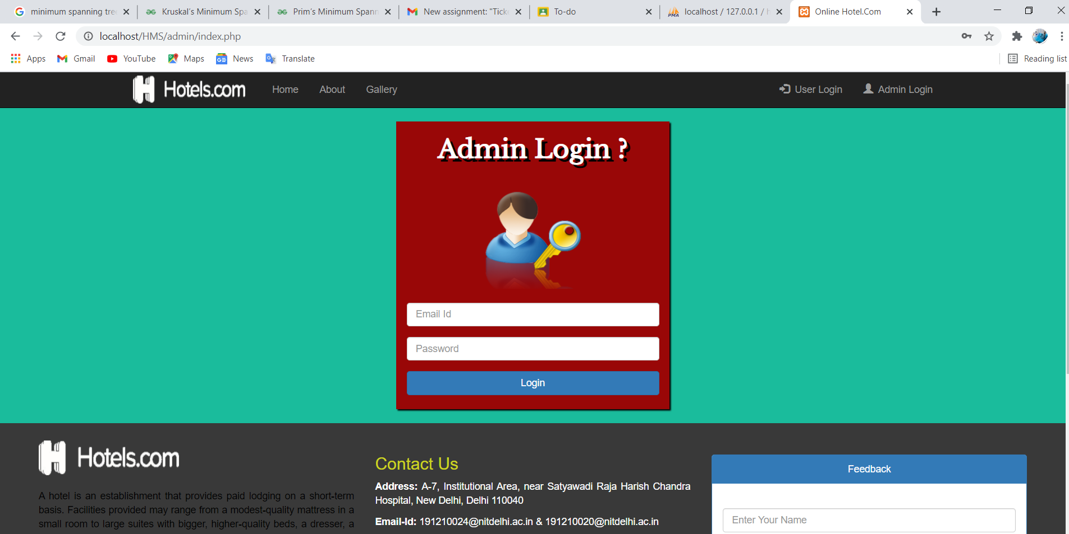
Here only admin have the access to login

Slide 17
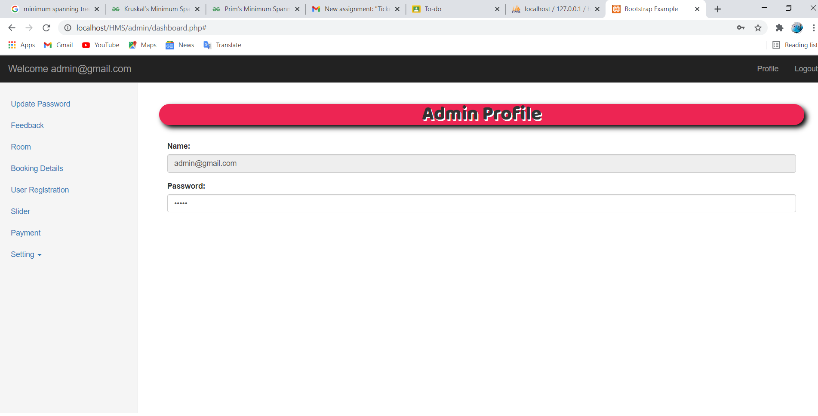

Slide 18
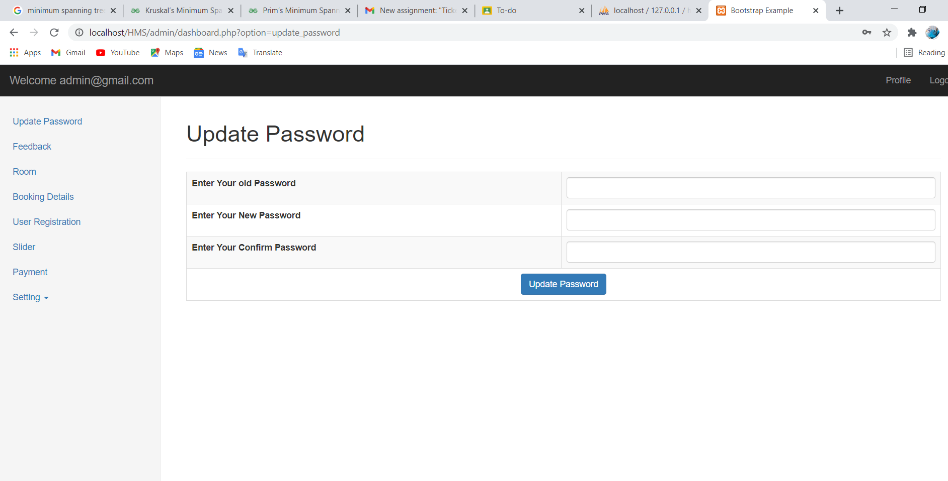

Slide 19
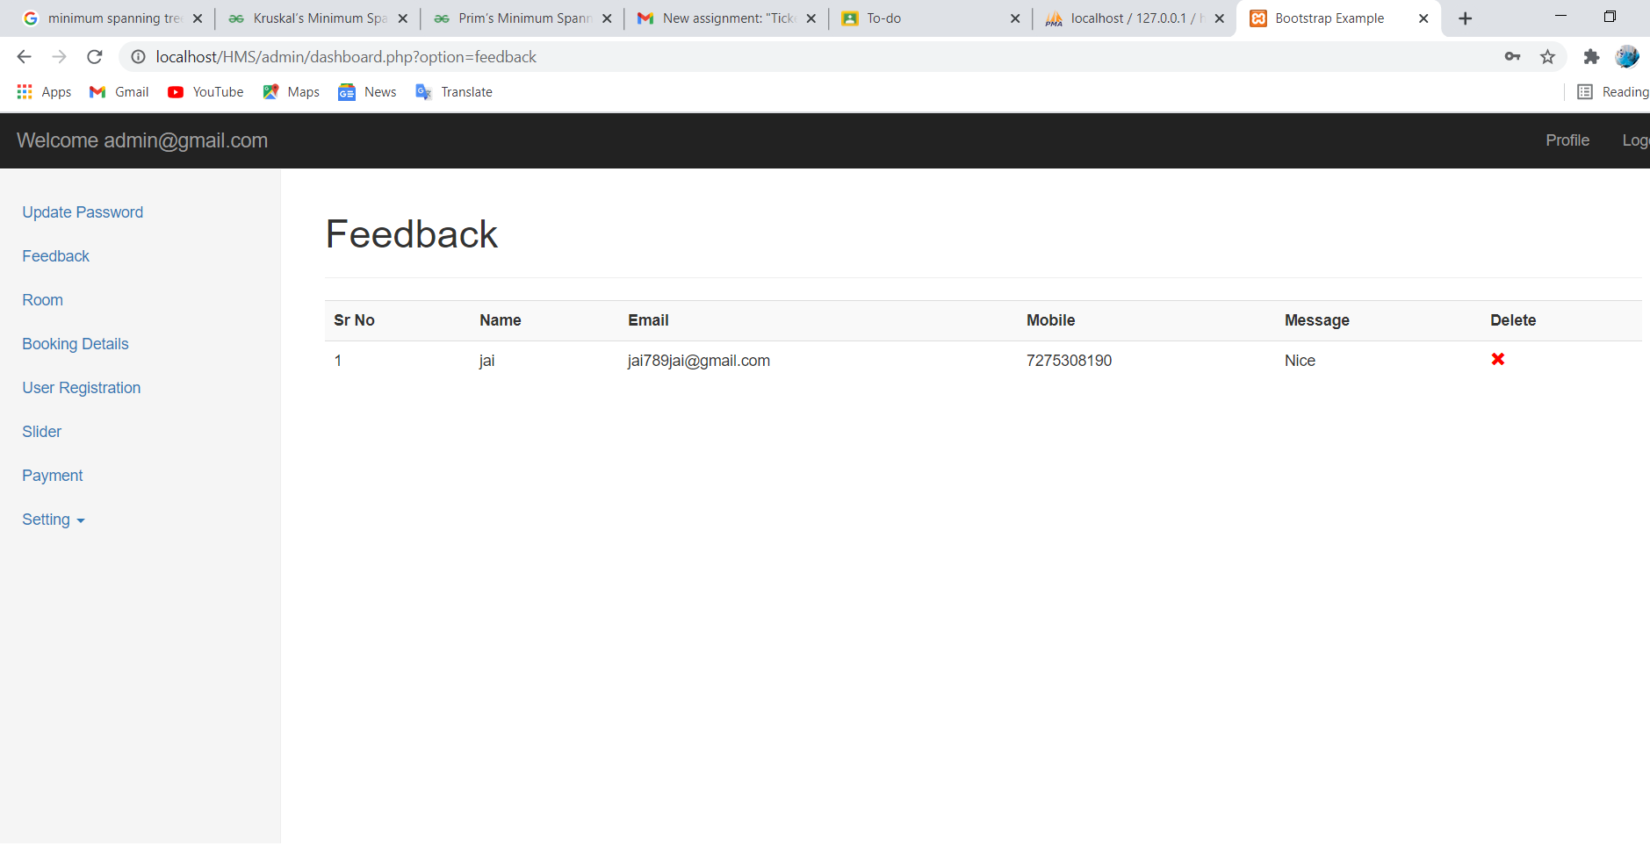

Slide 20
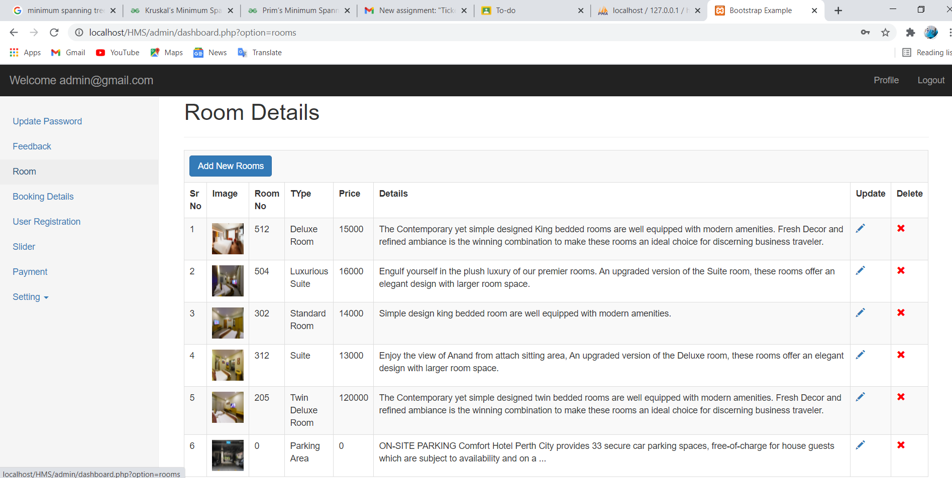

Slide 21
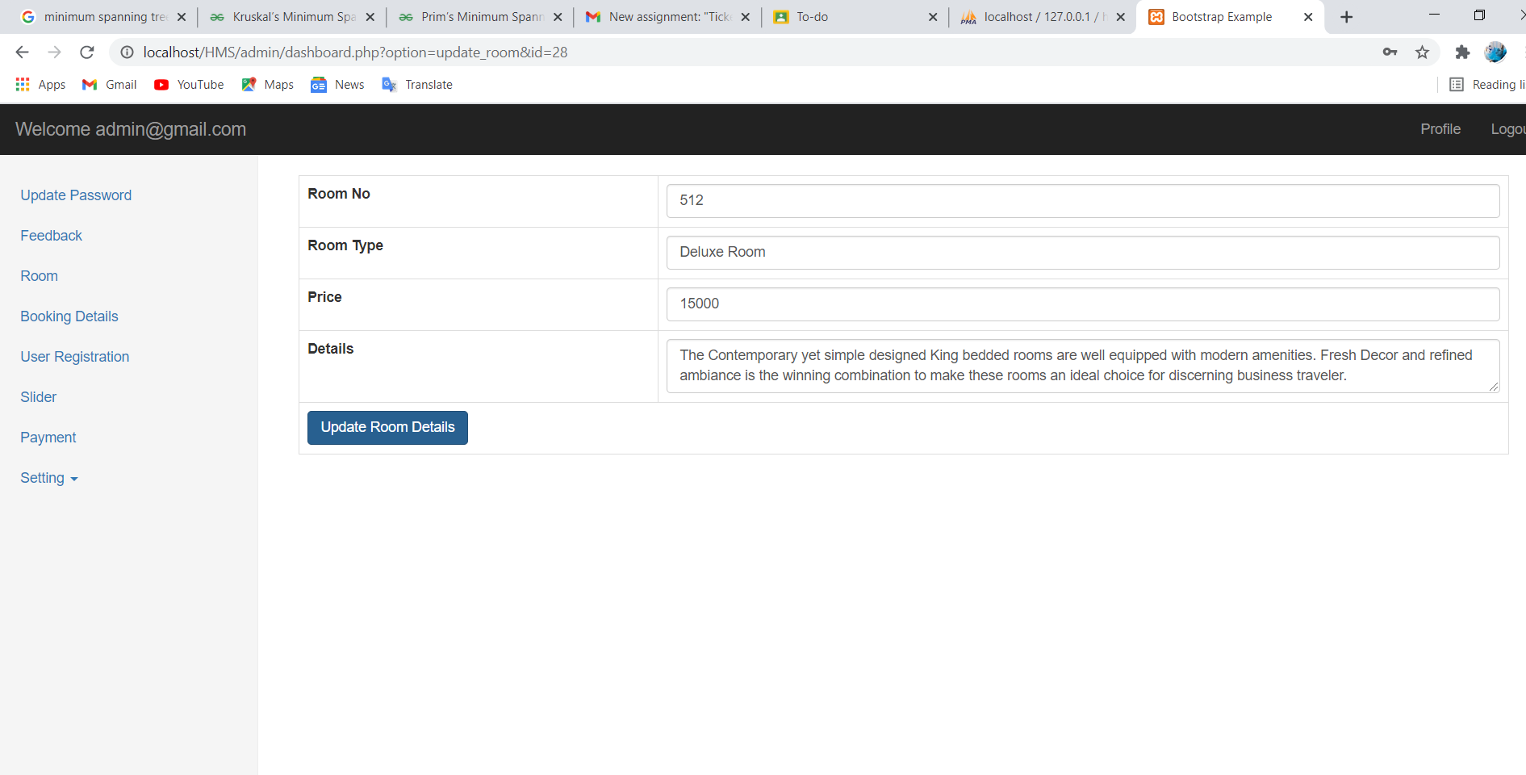

Slide 22
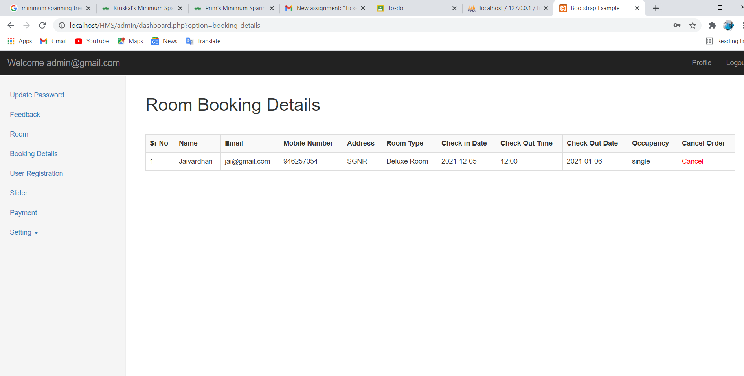

Slide 23
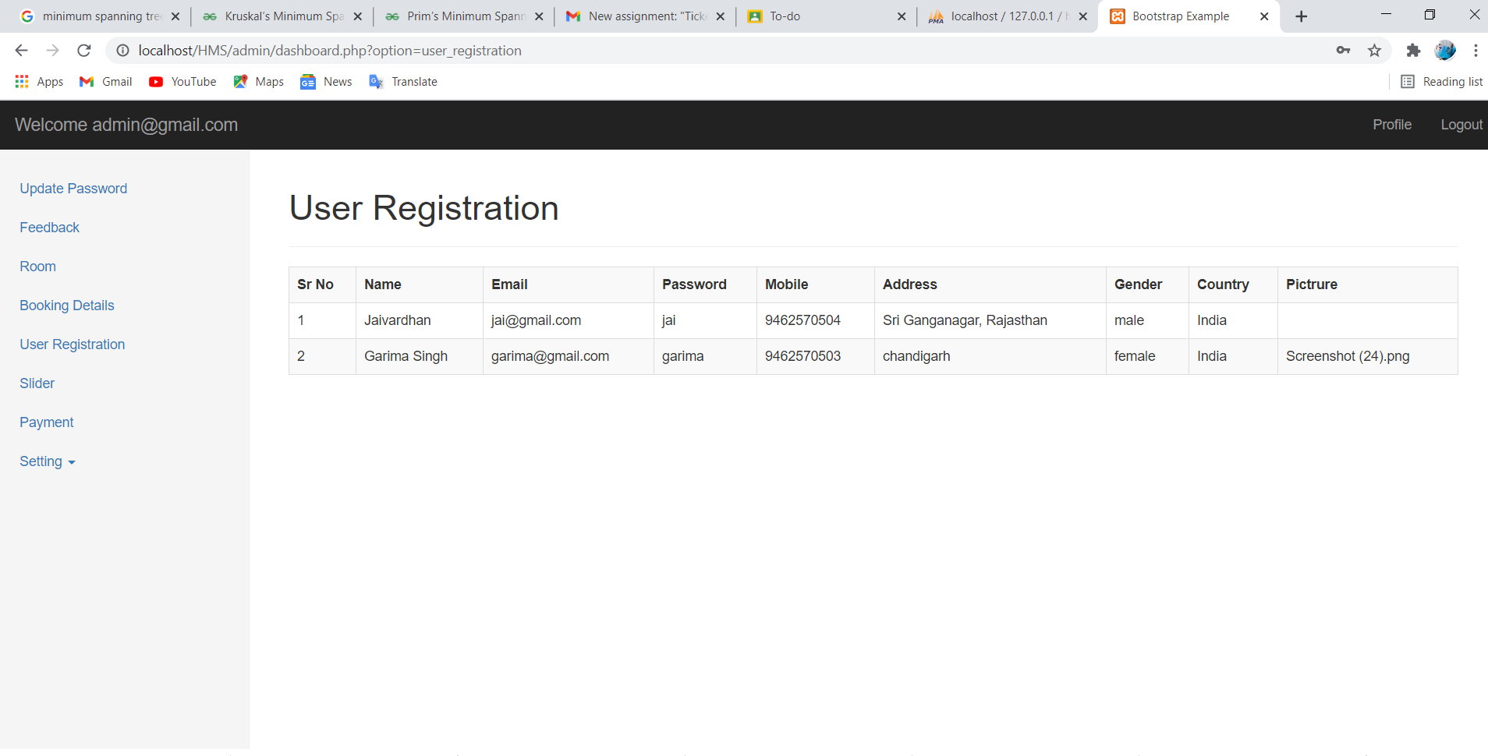

Slide 24
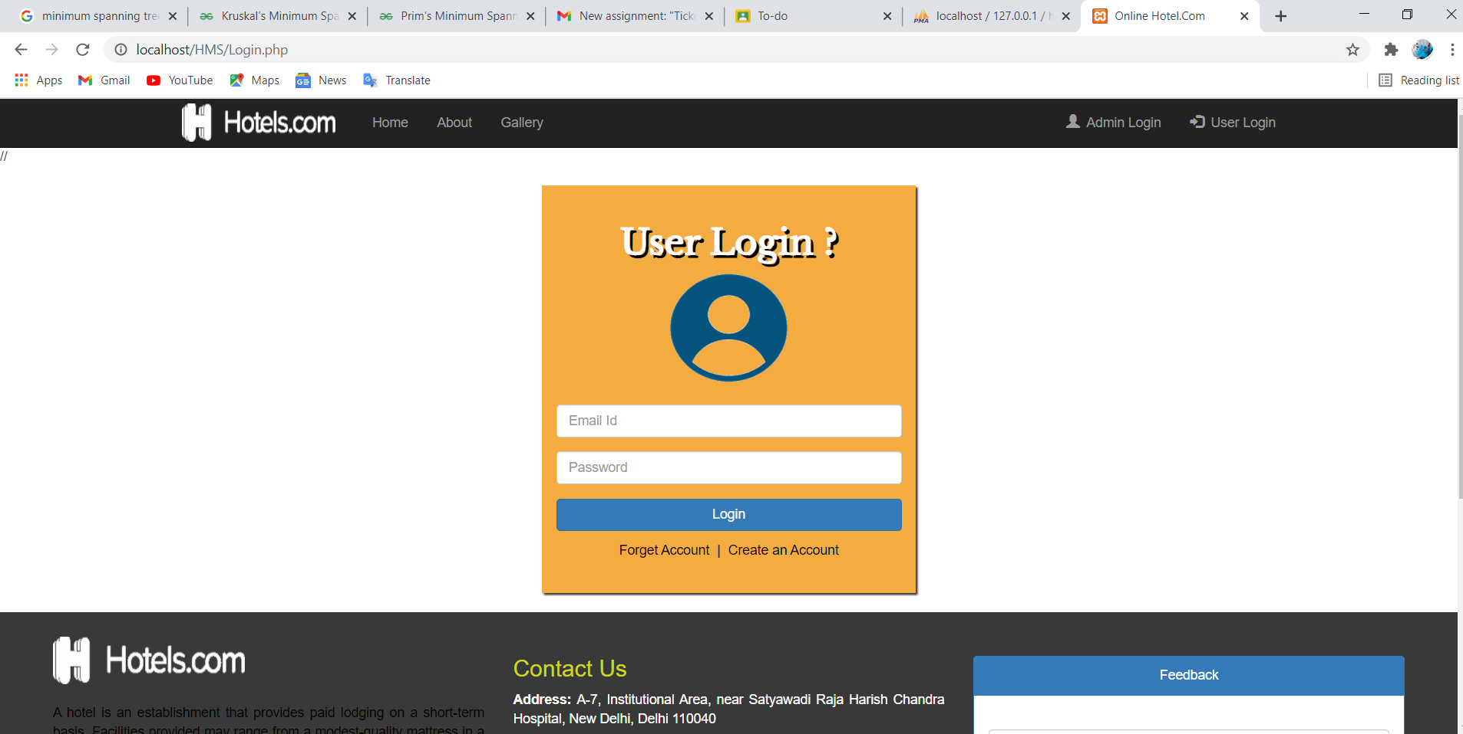
User’s can login here

Slide 25
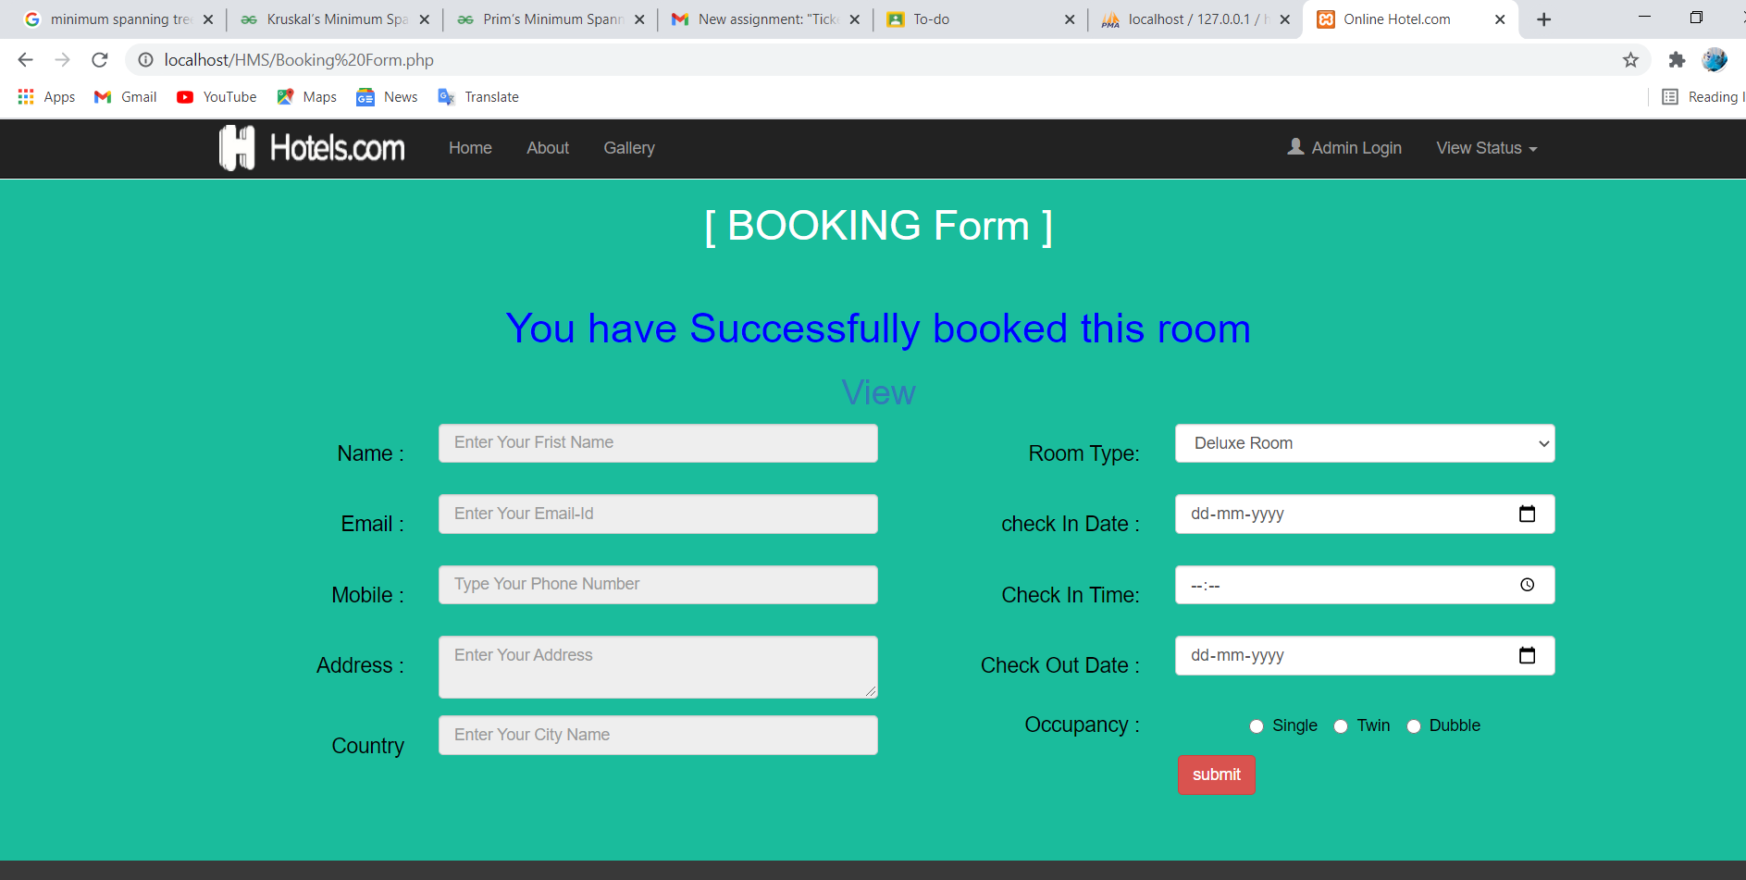
User can book a room by filling the details

Slide 26
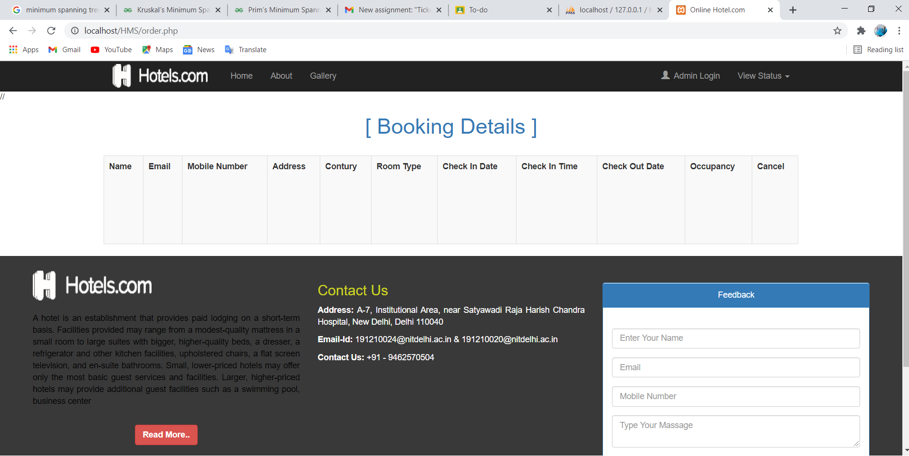
After successful booking this will appear

Slide 27
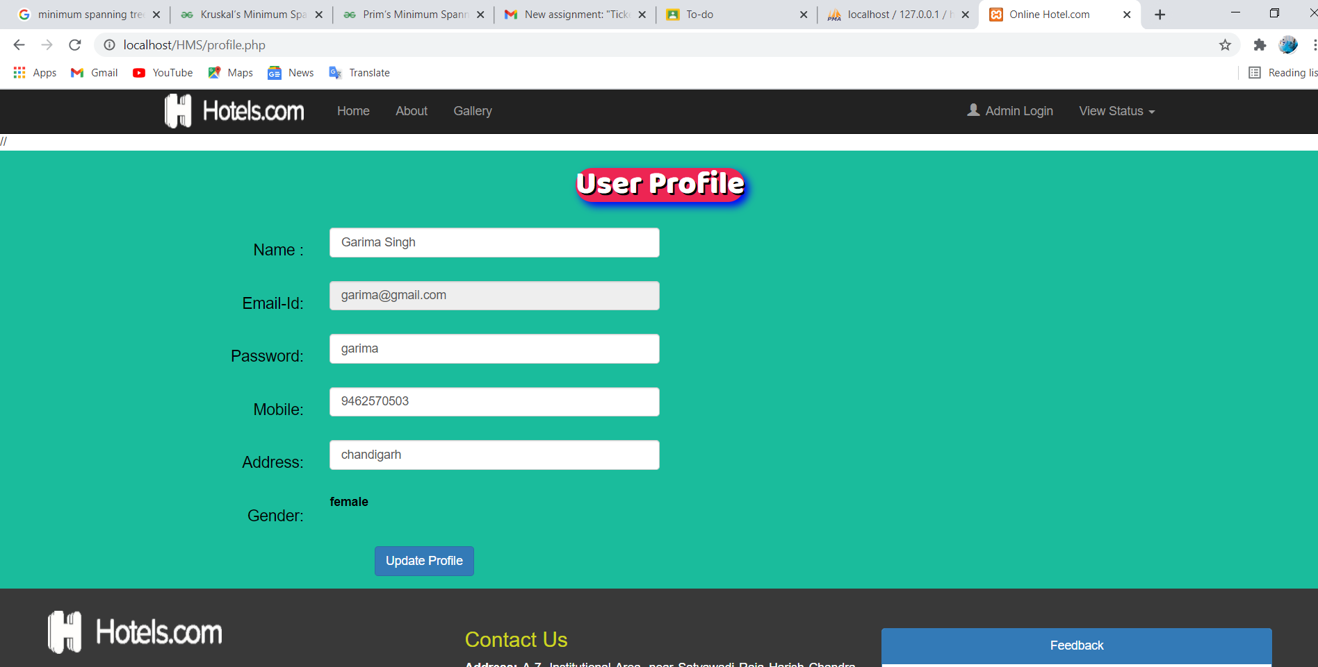
User Profile Update

